Slide 1
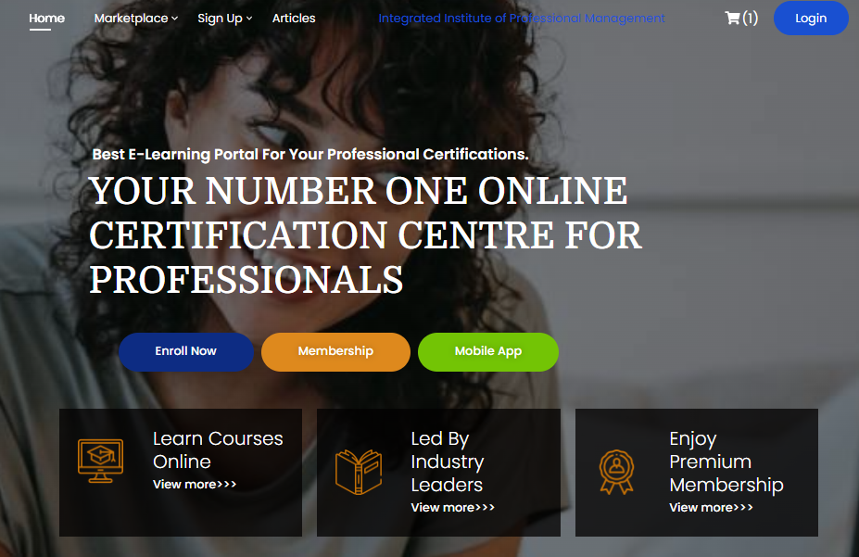
E-LEARNING PORTAL DOCUMENTATION
INTEGRATED INSTITUTE OF PROFDESSIONAL MANAGEMENT

Slide 2
Contents
Accessing The E-Learning Portal
E-learning Account Opening
Logging In (Also Inside is Recovering your password)
Accessing Your Dashboard
Assessing The Course List
Enrolling For A Course
Making Payments
Accessing Your Classes
Doing Assignment
Writing Examination
Getting Certificate
Becoming a Professional Member

Slide 3
You Are Welcome!
Welcome to the Integrated Institute of Professional Management (IIPM); the home of professionals.
This documentation provides information on how to use the IIPM Elearning Portal.
Should you have any question, please always feel free to reach out to us.

Slide 4
IIPM E-LEARNING PORTAL IN BRIEF
The E-learning portal is created to provide quality learning and certification experience for professionals all across the globe.
With this platform;
You can learn at your own comfort and convenience from any part of the world.
Have access to industry and experienced professionals
Network with like minds.
Track your learning and certification.
Make payments in your own local currency, cryptocurrency and in installments.
Get certified immediately after completing your course, and
Many more

Slide 5
Accessing The E-Learning Portal
There are two primary routes to access the portal;
1. Through the official e-learning portal website at https://elearning.iipmi.org.
However, you can also navigate to the portal via our main site at https://iipmi.org.
2. Through the portal mobile app which you can download and install in your mobile device. You can also download it from the e-learning website from the homepage.

Slide 6
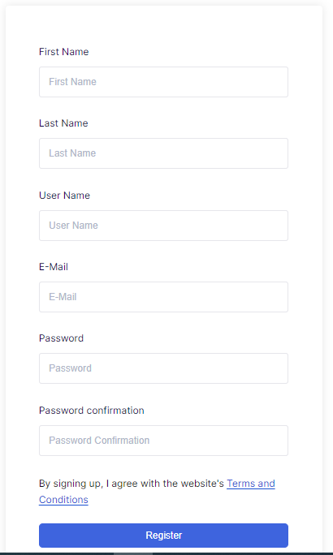
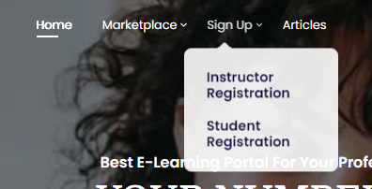
Creating Your E-Learning Account
To begin your amazing learning experience, you need to create an account.
To begin,
go to https://elearning.iipmi.org
Click on Sign-Up menu button
Click on Student Registration
Fill in your details and submit
You will receive a notification email of your account opening.
Congratulations, you are done.
Homepage
Please, always ensure to remember your username, email address and password as you will need them to access your dashboard.
Select this
Click on Register after filling your details

Slide 7
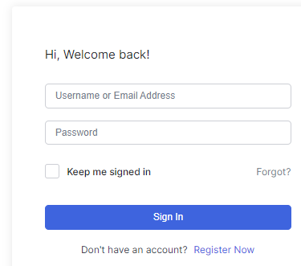
Logging In To Your Account
Login
From the Homepage, click on Login.
Fill in your login details
You will be directed to your dashboard.
Should you forget your password, use the FORGOT? Function and follow the instructions.
Sign In after filling your login details
In case you forgot your password

Slide 8
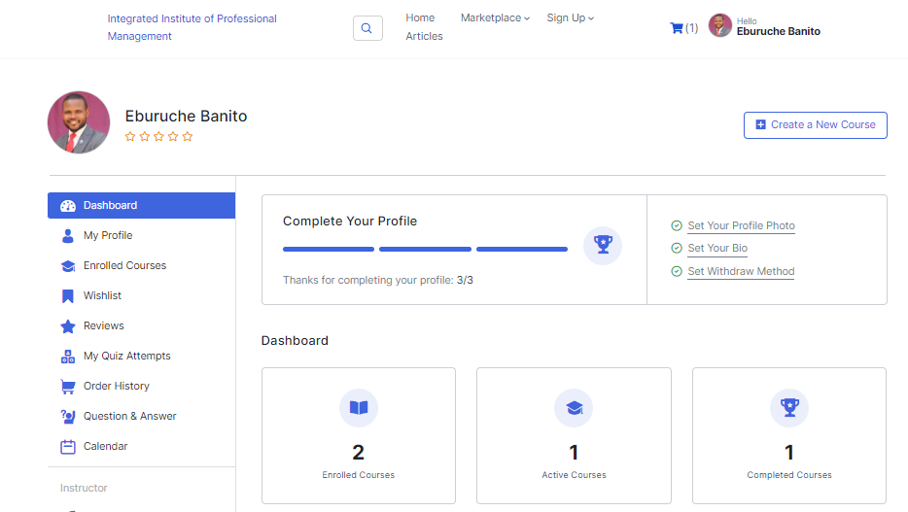
Accessing Your Dashboard
After logging in, you will be redirected to your dashboard.
The dashboard gives you access to your:
View and Edit your Profile
View your enrolled courses
View your quizzes
View your order history
Q&A Forum
You can also apply to be an Instructor from your dashboard.

Slide 9
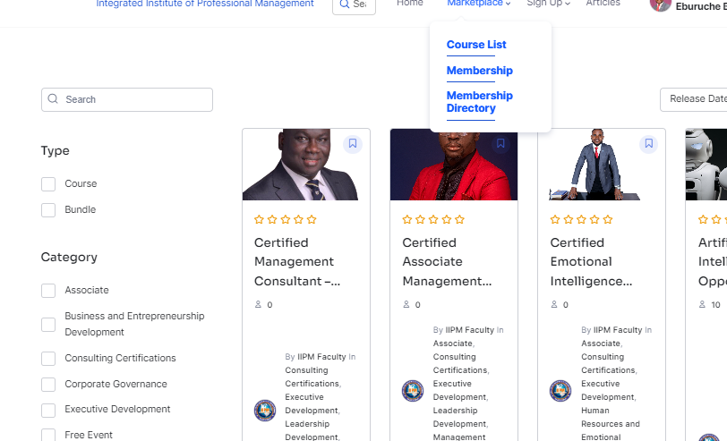
Assessing The Course List
To view all courses available, go to the MARKETPLACE and select COURSE LIST.
Or you simply enter this link in your browser: https://elearning.iipmi.org/courses/
Click here to view all courses

Slide 10
Searching for a Course
After clicking on Course List, you can streamline your search by using the parameters indicated.
You can use, type, category, both or other filters.
Filter courses using these filters

Slide 11
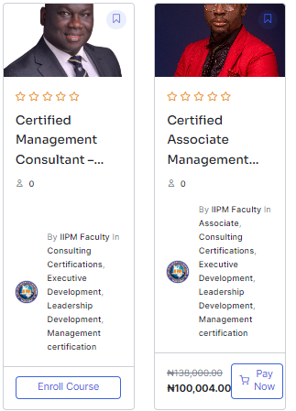
Enrolling For A Course
After searching out your course of interest, for FREE Courses, click on ENROLL COURSE to begin your learning.
For PAID COURSES, kindly click on PAY NOW to begin the enrollment process.
After clicking on PAY NOW, click on VIEW CART to checkout.
Free Courses
Paid courses

Slide 12
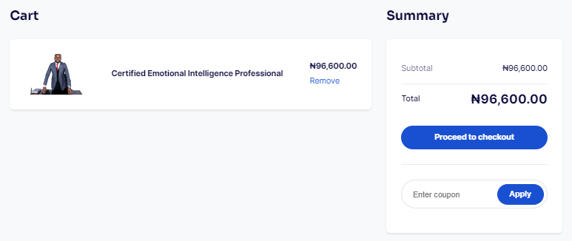
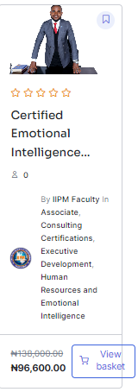
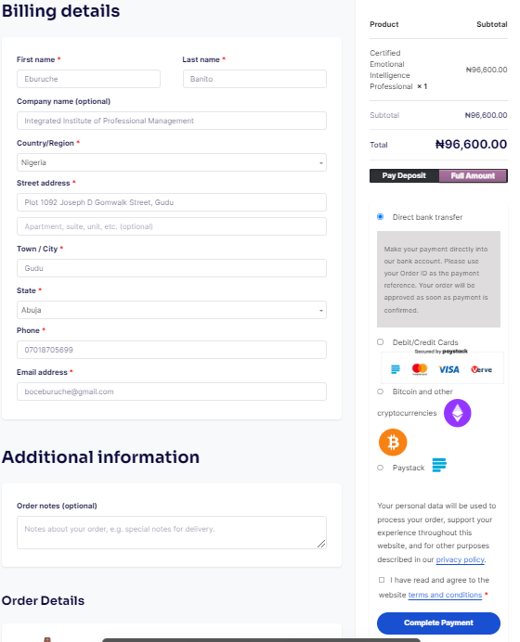
Making Payments
Fill in your coupon code (if any)
After clicking on PAID NOW,
Click on VIEW CART
Fill out the details and proceed to check out.
Choose your mode of payment whether Deposits or Full
Select your payment gateway
Check the terms and conditions box
And proceed.
Payments can be made via bank deposits, cards or cryptocurrency.
Select either Deposits or Full Payment
Select your preferred payment gateway
Free Courses
Check this box
Complete payment

Slide 13
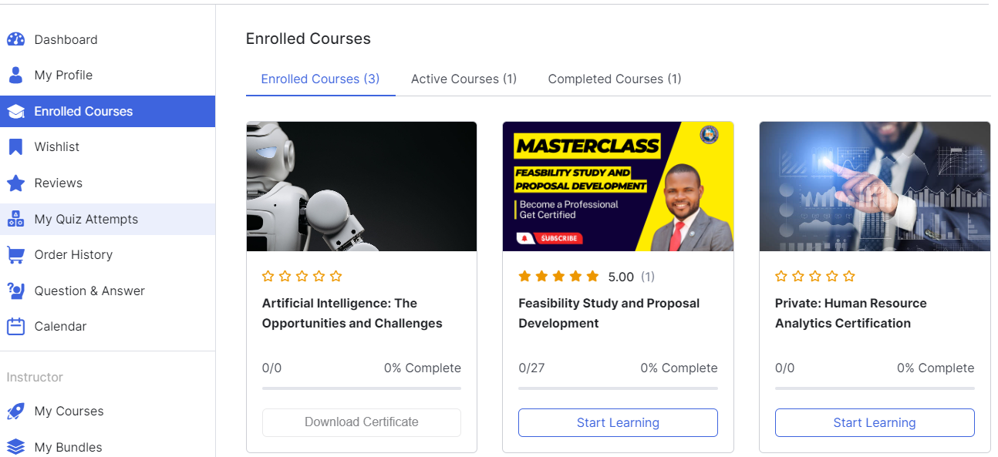
Accessing Your Classes
After completing your payment or enrolling, you are automatically redirected to the classes for the course(s) you enrolled for.
However, when you logout, you will have to go to your dashboard or hover over your profile icon/picture then click on Enrolled Courses.
Then click on Start Learning or Continue Learning depending on whether you are just starting out on the course or you are returning.
Your Courses

Slide 14
Assignments, Tests and Examination
From your dashboard, kindly click on MY QUIZZ ATTEMPTS.
You will see all open assessments.
Click on the one you need to take and attend to it.
Free Courses

Slide 15
Downloading Certificate
After completing your course, you will notice “Download Certificate”
Kindly download and keep safe.
Note: Not all courses have certificate button actively immediately. Some will be activated after verification.
Certificate

Slide 16
Becoming A Member
Unlock a world of unlimited opportunities in the dynamic field of management with our professional membership.
Join this prestigious community of industry professionals to gain access to a wealth of resources, networking opportunities, and professional development support.
Visit https://elearning.iipmi.org/membership-2/ to begin your membership enrollment.

Slide 17
Membership Levels

Slide 18
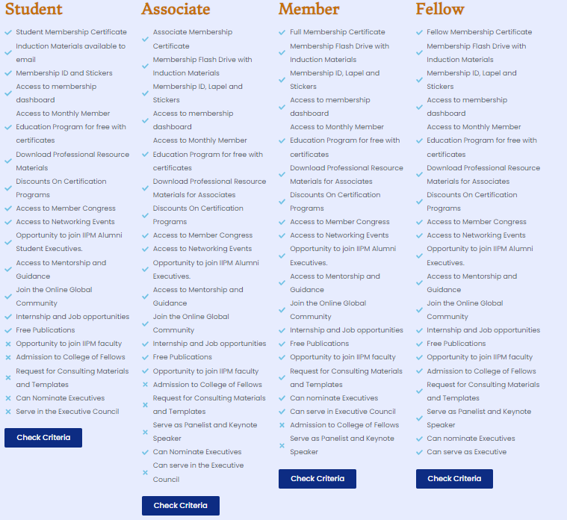
Membership Benefits

Slide 19
Membership Criteria
Student Member
Be currently enrolled as a student in a recognized educational institution, pursuing a degree or higher diploma;
Provide a valid student identification card or proof of enrollment from your educational institution;
Complete the student membership application form provided by IIPM;
Agree to abide by the professional code of conduct and ethical standards set by IIPM;
Show a genuine interest in the field of management and a commitment to actively engage with IIPM’s resources and opportunities. This will include attending events, workshops, and seminars organized by IIPM specifically for student members.
Associate Member
Must have a Bachelors’ Degree, HND or equivalence
2 – 4 years work experience.
Pay the prescribed membership fee or dues as determined by IIPM.
Complete the application form.
Provide references from professionals or individuals who can vouch for your expertise and competence in the field of management.
Attend the Institutes Membership Induction Session.
Agree to abide by the professional code of conduct and ethical standards set by IIPM.

Slide 20
Membership Criteria
Full Member
a Bachelor’s Degree, Higher National Diploma or equivalence with 7 to 10 years relevant work experience; or
a Master’s degree with with 4 to 5 years relevant work experience;
Demonstrate a record of notable professional achievements and contributions in the field of management. This may include successful project outcomes, leadership roles in organizations, published works, patents, awards, or recognition within the industry;
Provide two strong references from professionals or individuals who can attest to your expertise, leadership abilities, and significant contributions in the management field;
Complete the membership application form provided by IIPM, which typically includes personal and professional information, details of your education and work experience, and a summary of your achievements and contributions in the field of management;
Complete the IIPM Induction program; and
Pay the prescribed membership fee or dues as determined by IIPM.
Fellow
Must have a Bachelor’s degree with minimum 15 years of relevant work experience; or
a Master’s degree with a minimum of 10 years of relevant work experience; or
a PhD/DBA with a minimum of 7 years of relevant work experience;
Provide evidence of significant contributions to the field of management. This will include published research papers, books, articles, case studies, or innovative practices that have made a notable impact on the industry;
Demonstrate thought leadership by delivering keynote speeches, presentations, or workshops at prestigious conferences, symposiums, or industry events. Your participation as a panelist, moderator, or expert speaker should highlight your expertise and influence in the management community;
Receive accolades, awards, or honors from reputable organizations, institutions, or professional bodies in recognition of your outstanding contributions to the field of management;
Obtain strong recommendations from senior professionals, experts, or renowned individuals who can validate your exceptional achievements and contributions in the management field;
Undergo the Induction sessions; and
Pay the prescribed membership fee or dues as determined by IIPM for fellow membership.

Slide 21
Membership Enrollment
Visit https://elearning.iipmi.org/membership-2/ to begin your membership enrollment.

Slide 22
Thank You
Should you have any questions, please contact us via:
Email: training@iipmi.org,
Whatsapp: + 2348147029035, or
Chat us up from our website.

